Slide 1

Neural Network based Image Classification System on Heterogeneous Platforms
Linjuan Fan- Ibrahim Bouriga- Andres Stober- Bahaa Mahagne Mehyar Cherni

Slide 2
Architecture Description

Slide 3
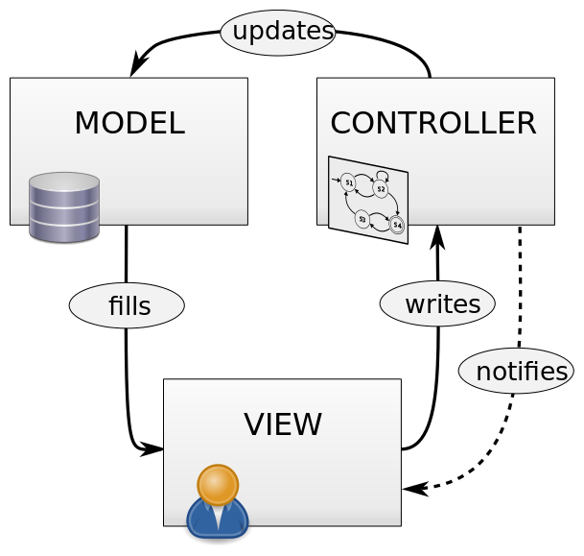
In this diagram several design patterns were used. In order to decouple major components and allow parallel development we use the Model-View-Controller as a global architecture
This Photo by Unknown Author is licensed under CC BY-SA
Praxis der Software Entwicklung - Practice of Software Development

Slide 4
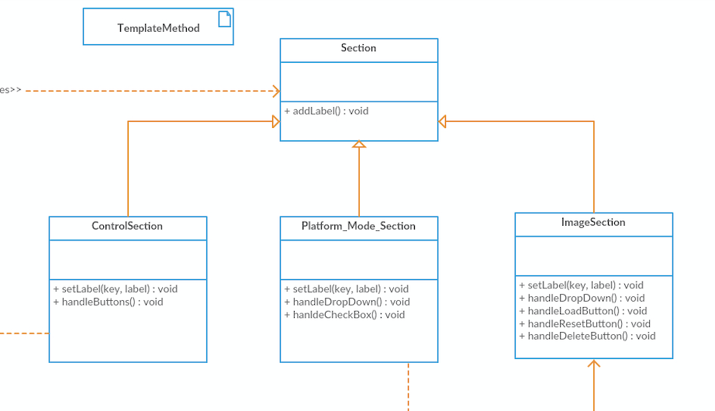
The class diagram consists of several common patterns to reduce complexity and dependencies between classes. We use the template Method as pattern for sections to define the skeleton of the algorithm in an operation.

Slide 5
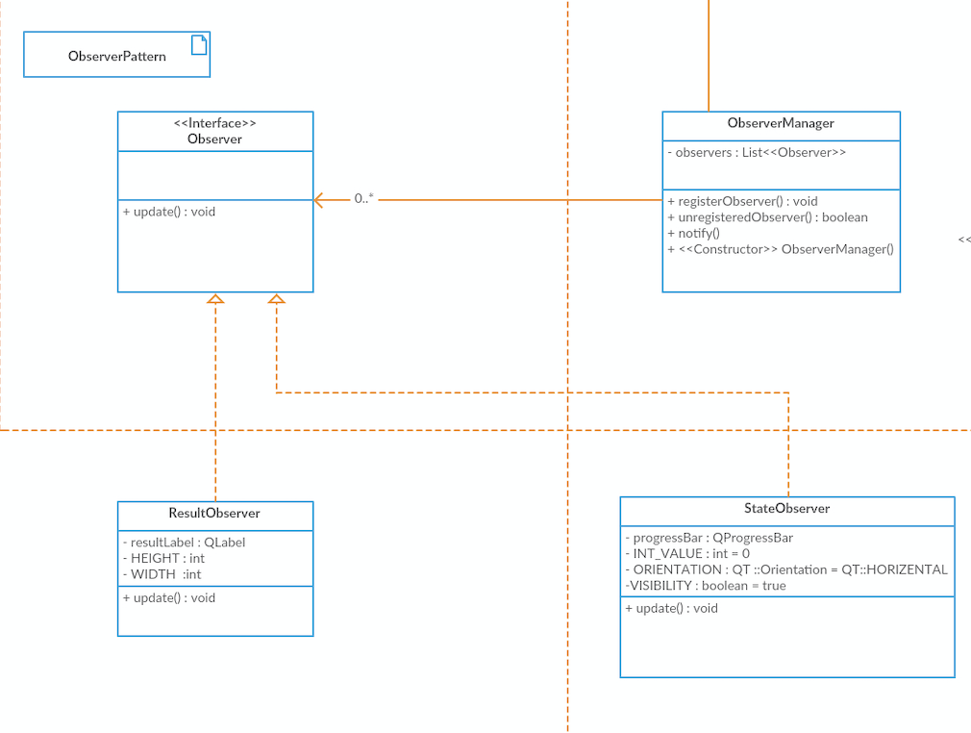
However the results and states are updated using an observer which defines a one-to-many dependency between objects.

Slide 6
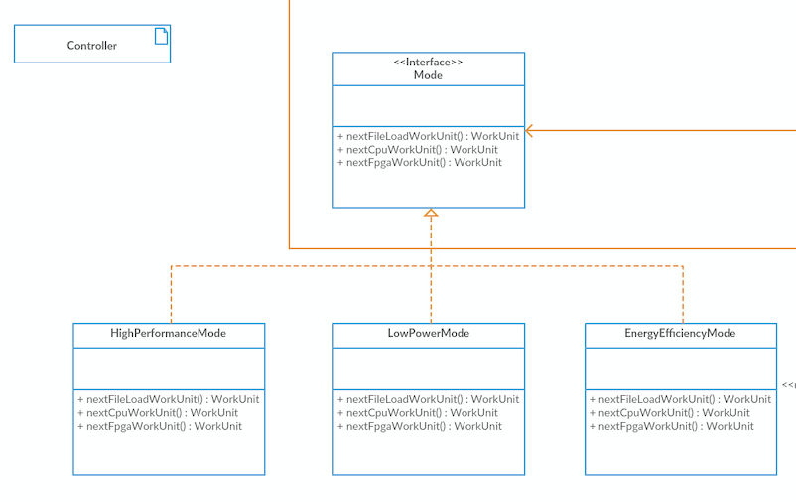

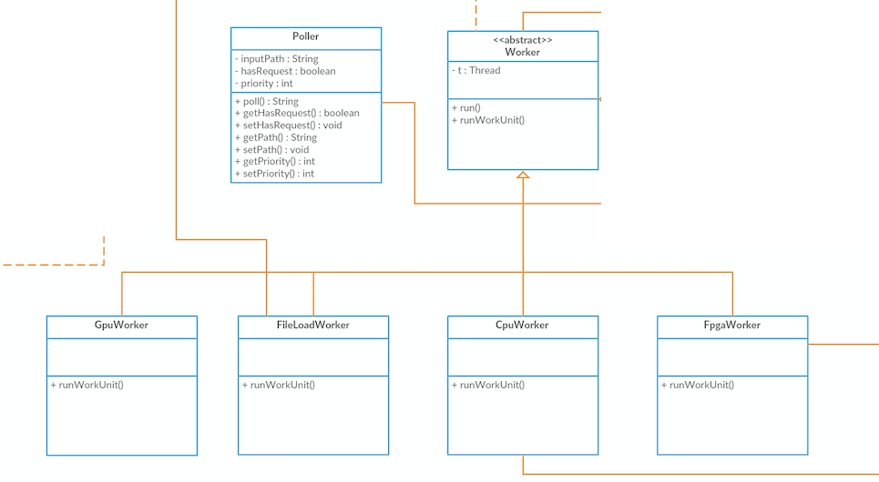
Different Modes as well as Worker are represented by simple is-relationships.

Slide 7
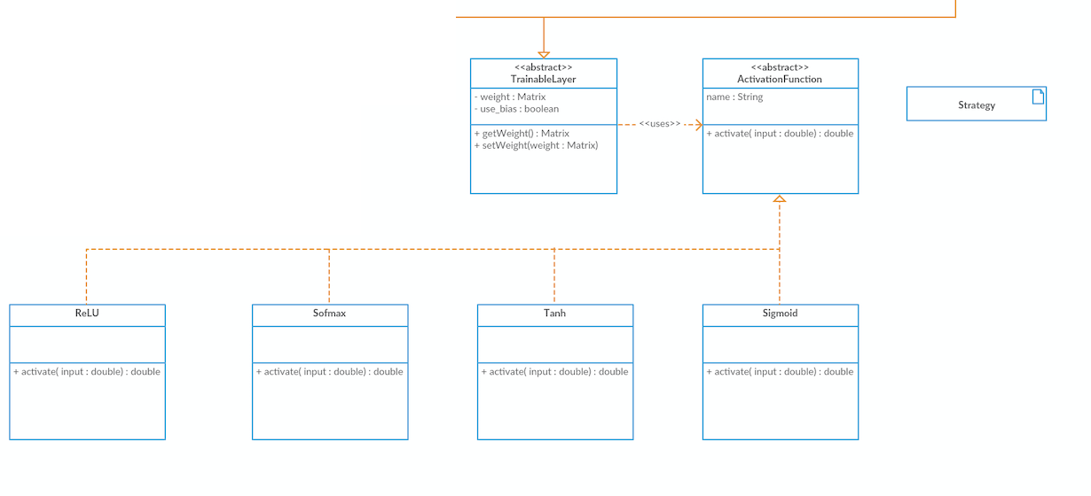
Another interesting pattern to be used by layers is the strategy-pattern.

Slide 8
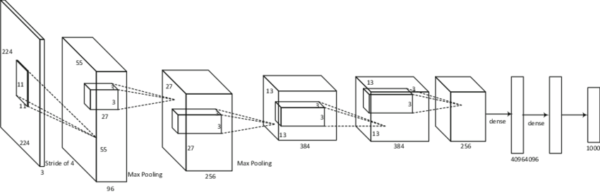
In this context we define a family of algorithm, encapsulate each one and make them interchangeable. This approach also lets the algorithm vary independently from the layer that uses it.
This Photo by Unknown Author is licensed under CC BY-SA

Slide 9
UML Class Diagram
Praxis der Software Entwicklung - Practice of Software Development

Slide 10
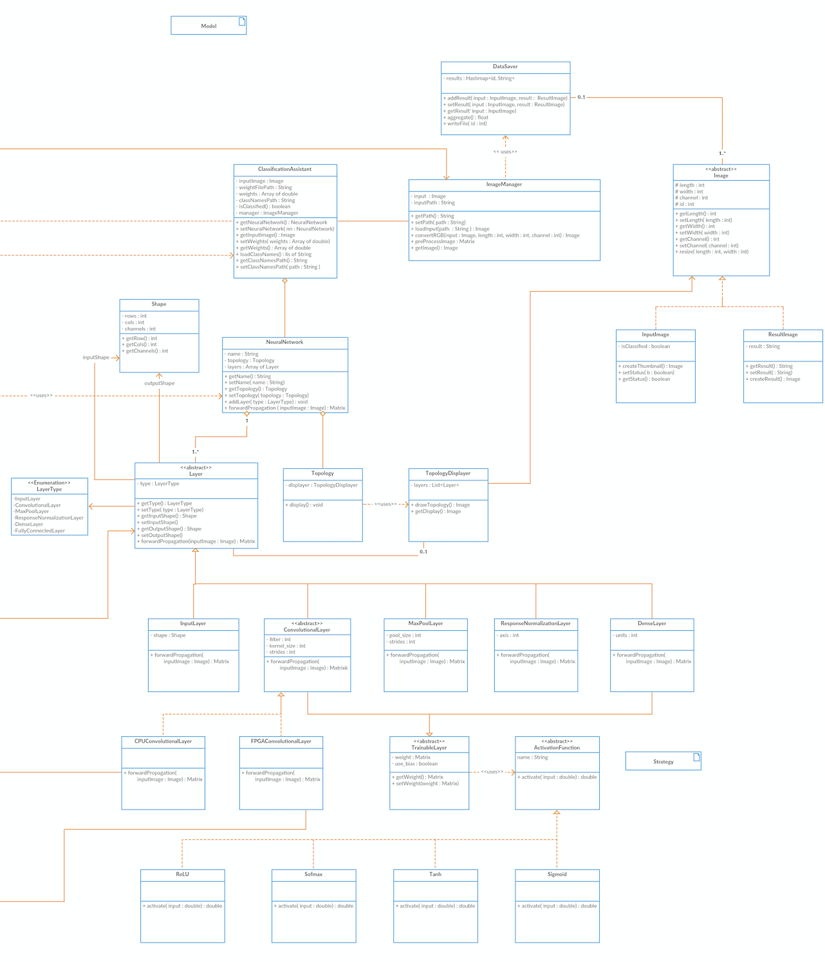
Model
Praxis der Software Entwicklung - Practice of Software Development

Slide 11
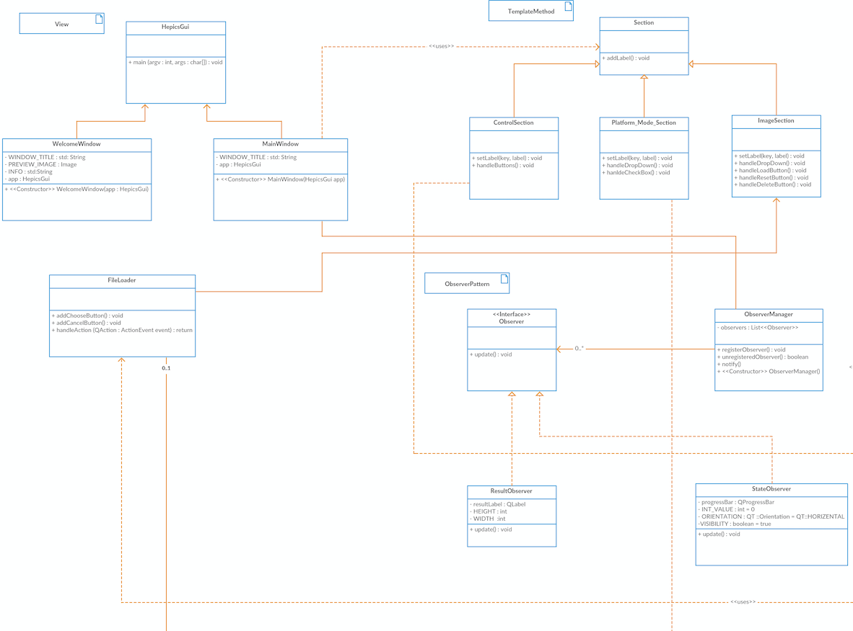
View
Praxis der Software Entwicklung - Practice of Software Development

Slide 12
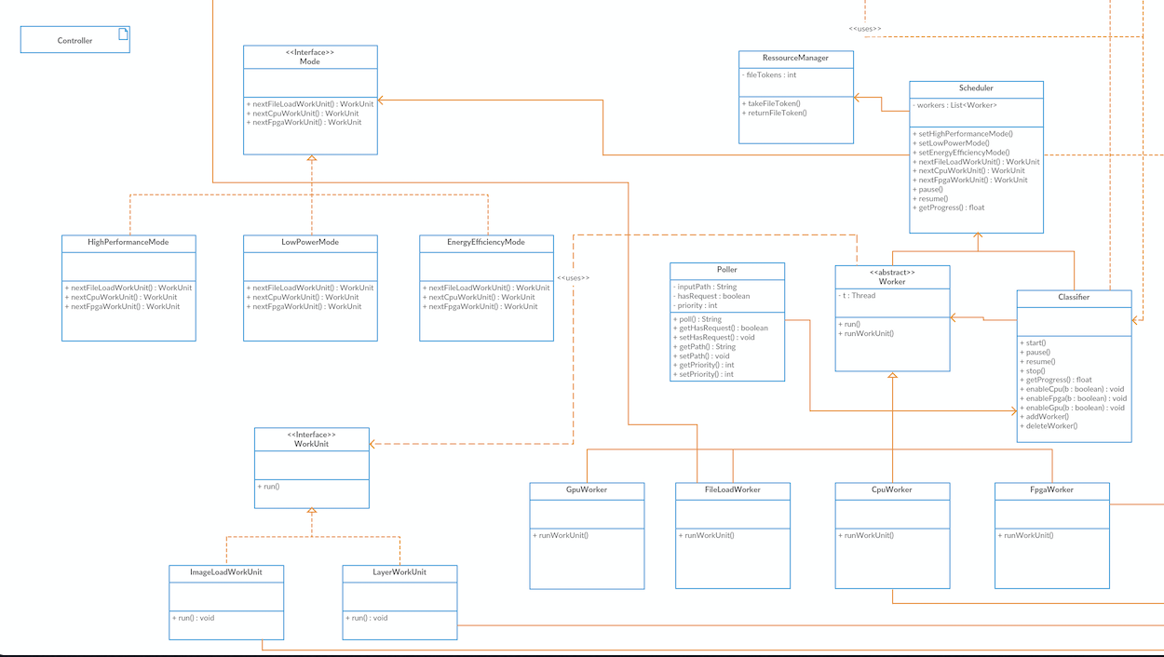
Controller
Praxis der Software Entwicklung - Practice of Software Development

Slide 13
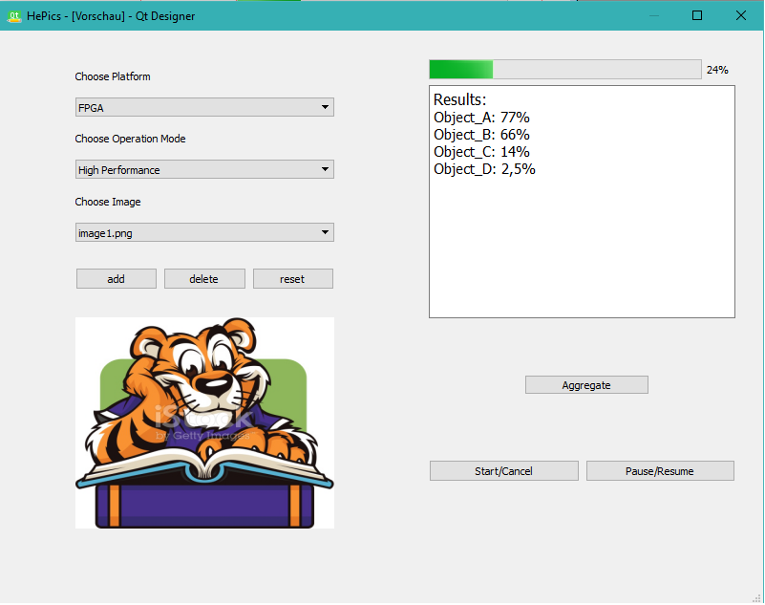
Classes on GUI
Platform-Mode
Section
Results observer
Image section
Control section

Slide 14
Functionality Description

Slide 15
Model
In model part, the classes realize the management of all the data and logic. They load the path of images and access their features. The results of classification are stored in the type of string to be shown in various forms. The logic of classification is determined by the neural network being used. Its topology defines how diferent layers interact with each other. With the assistance of all the layers, the forward propagation functionality can be implemented, which is the core of algorithms for image classification with pre-trained model.
Praxis der Software Entwicklung - Practice of Software Development

Slide 16
View
realizes the user interfaces. The welcome window and the main window, which contains three different sections, guide the user to upload their input images, select available platforms and operating mode, let them control the process and show the prediction results.
Praxis der Software Entwicklung - Practice of Software Development

Slide 17
Controller
accepts user inputs handled by the components of the views and converts them to the commands. The classifier controls the progress of processing and assigns the scheduler to dispatch work to workers in heterogeneous platforms. In addition, the poller checks the requests from external systems regularly. After receiving the correct request with the image path, the classifier starts the process of classification.
Praxis der Software Entwicklung - Practice of Software Development

Slide 18
Sequence Diagrams

Slide 19
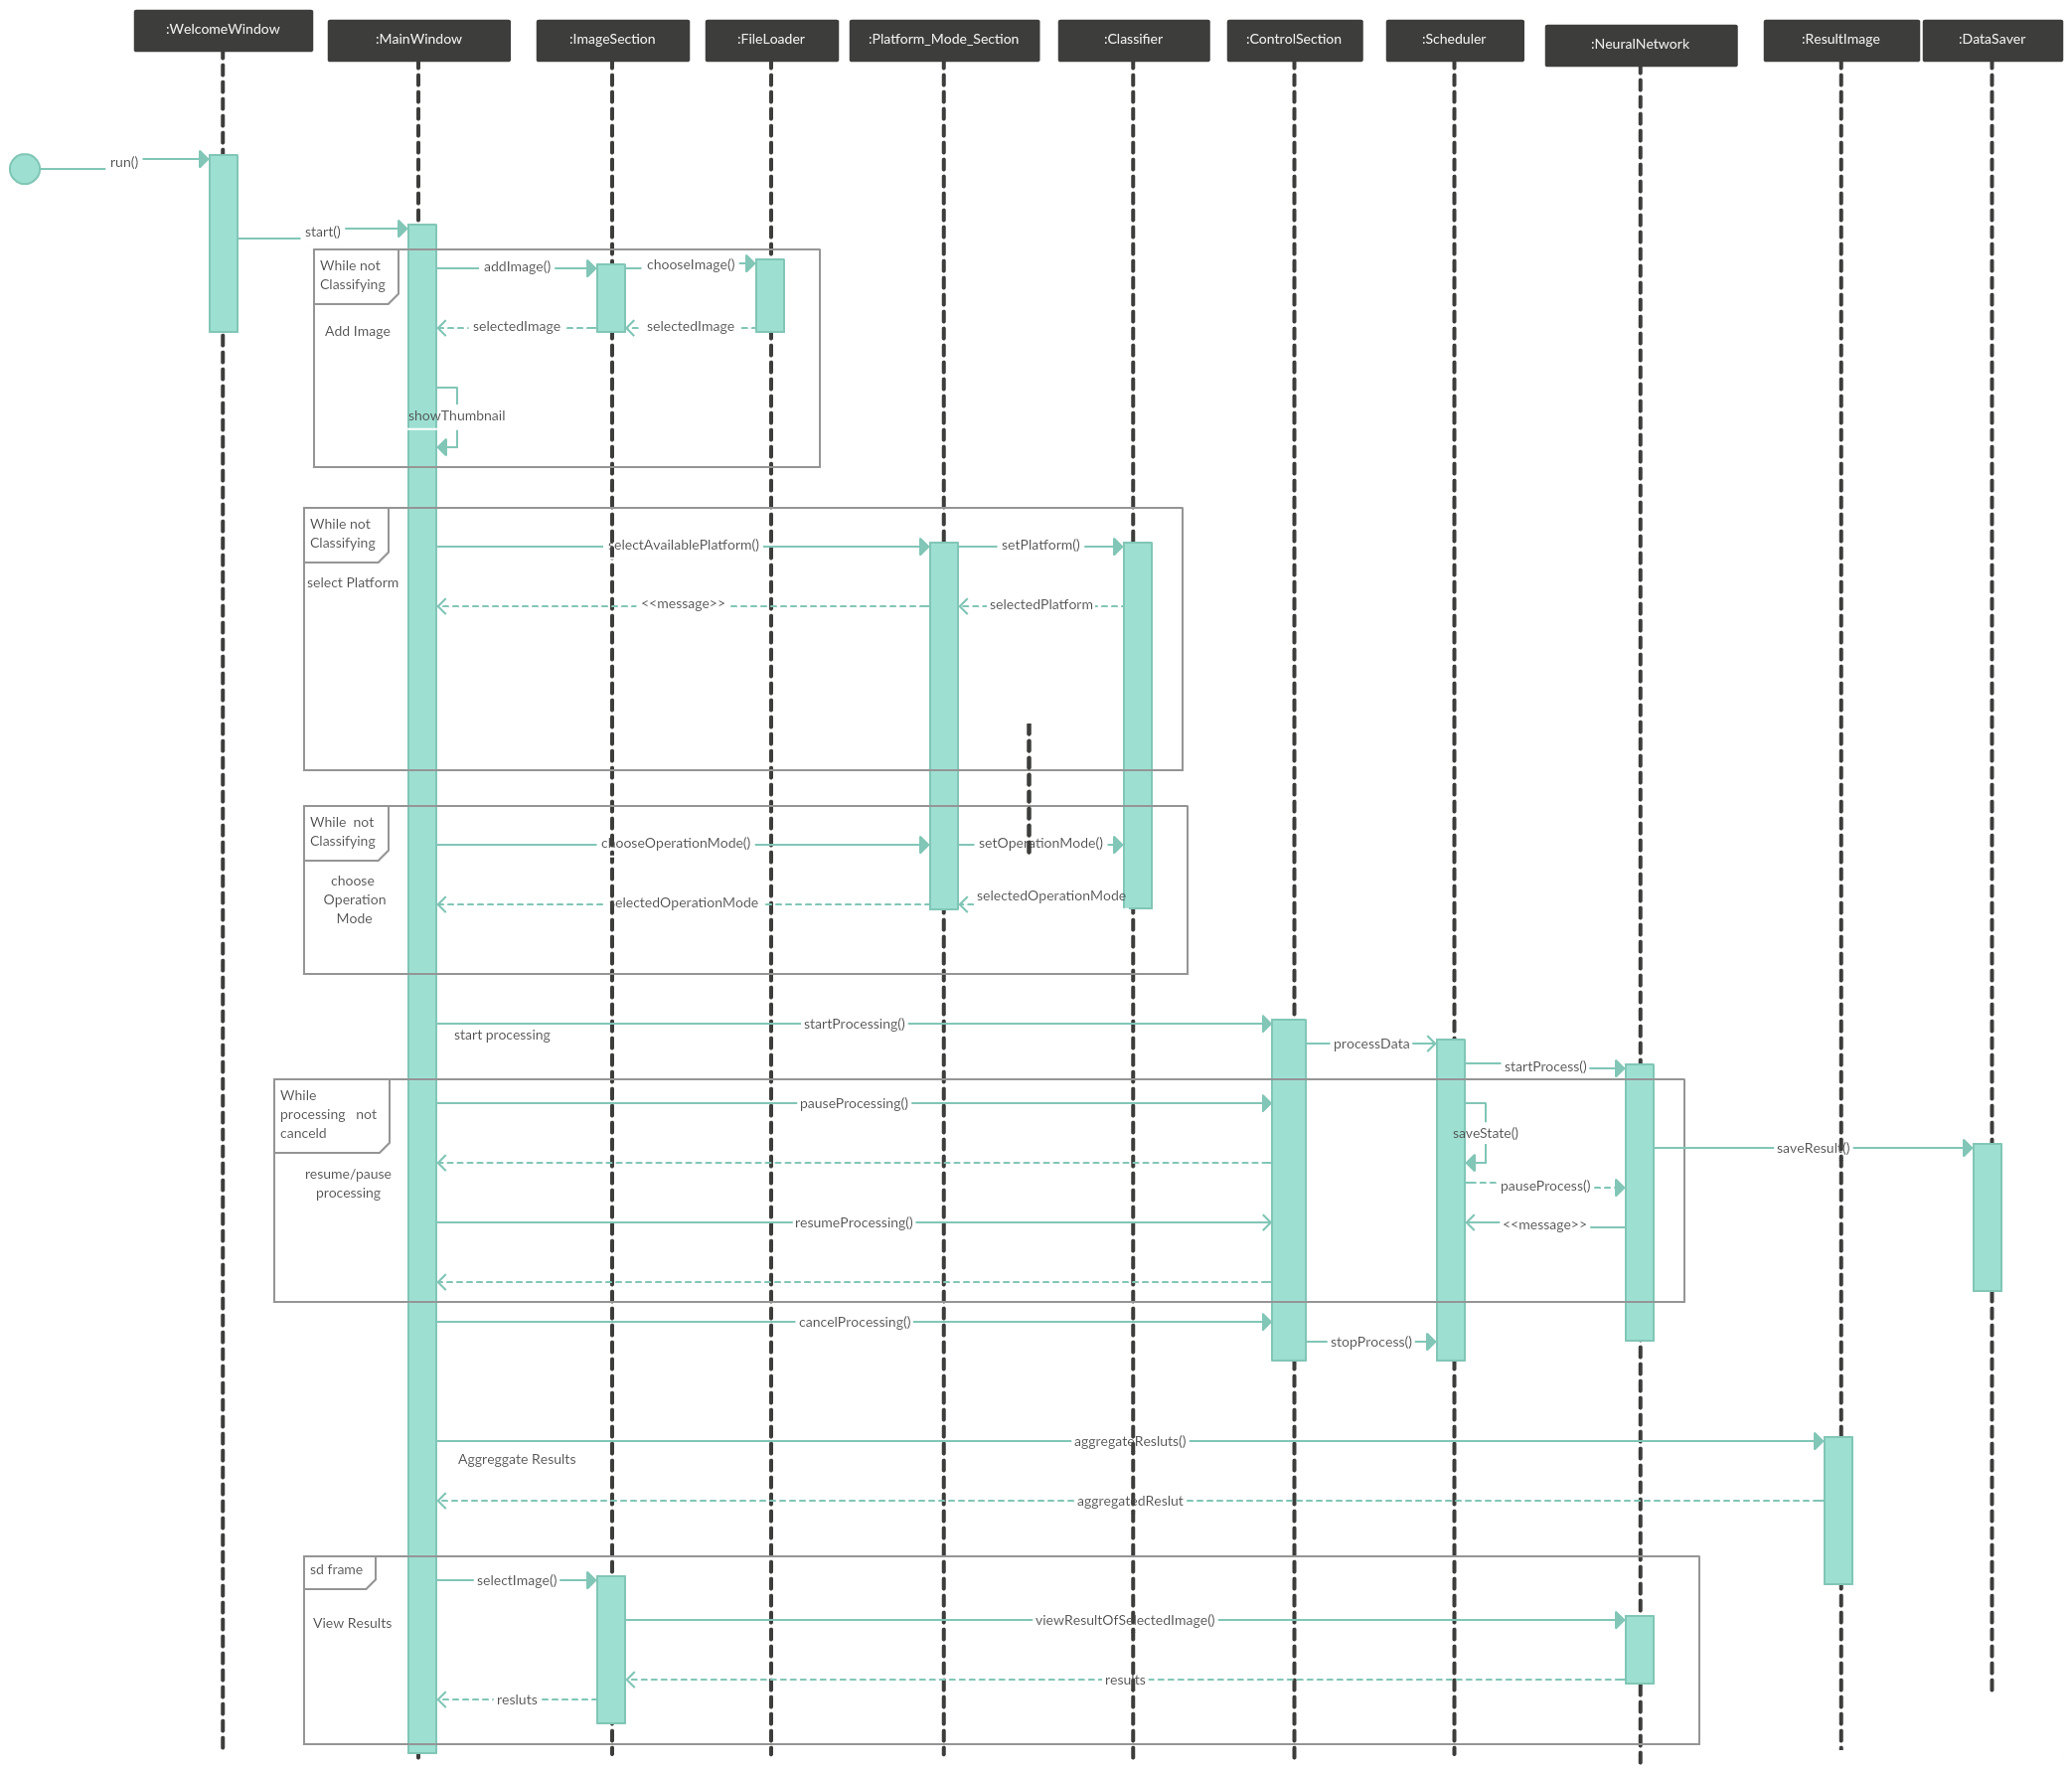
Praxis der Software Entwicklung - Practice of Software Development

Slide 20
State Diagram

Slide 21
